Slide 1

Customer Analytics
Unlocking Revenue Growth Through Data-Driven Segmentation

Slide 2

The Challenge
Business Need
Key Questions
E-commerce company needed deeper understanding of customer base beyond basic sales tracking.
Who spends most? What drives loyalty? How do discounts and shipping impact revenue?

Slide 3

Our Approach
Data Source
Technology
Methodology
Kaggle Customer Shopping Behavior Dataset with purchase records and demographics.
Python, SQL, and Power BI for analysis, aggregation, and visualization.
Segmentation, revenue metrics, and product performance analysis.

Slide 4
Customer Segmentation
New
1
0-1 previous purchases
Returning
2
2-5 previous purchases
Loyal
3
6+ purchases

Slide 5
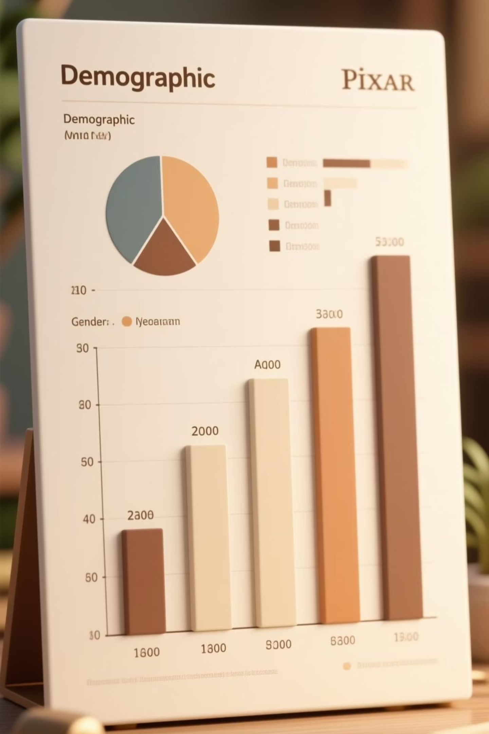
Revenue by Demographics
Higher
Top 2
Female Customers
Age Groups
Generated significantly higher total revenue than male customers.
25-35 and 45-55 were the highest revenue contributors.

Slide 6

Subscription Impact
Subscriber Value
Loyalty Correlation
Subscribed customers spend significantly more in both average spend and total revenue, confirming high effectiveness in increasing Customer Lifetime Value.
Strong correlation between repeat buyers and subscription adoption, indicating customers who value products eventually opt-in for recurring benefits.

Slide 7

Discount Strategy
High-Value Discount Users
Identified customers using discounts while maintaining above-average purchase amounts—ideal targets for personalized campaigns.
Top Discounted Products
Mapped where promotions concentrate to optimize marketing spend and protect profit margins.

Slide 8

Key Recommendations
1
Prioritize Subscribers & Loyal Customers
Focus marketing efforts on highest-return segments for maximum ROI.
2
Targeted Promotions
Create personalized discount campaigns for high-spenders rather than sitewide discounts.
3
Optimize Shipping Strategy
Use shipping analysis to determine thresholds that encourage higher customer spend.

Slide 9



Future Opportunities
Predictive Modeling
Forecast non-subscriber conversion likelihood for efficient marketing spend.
Profitability Analysis
Analyze COGS to identify most profitable products and customer segments beyond revenue.

Slide 10

Impact & Next Steps
What We Achieved
Resources
Clear customer value hierarchy
GitHub Repository: Complete Python notebooks and SQL scripts available at github.com/GouravBerwal
Actionable segmentation strategy
Data-driven promotion framework

